Slide 1
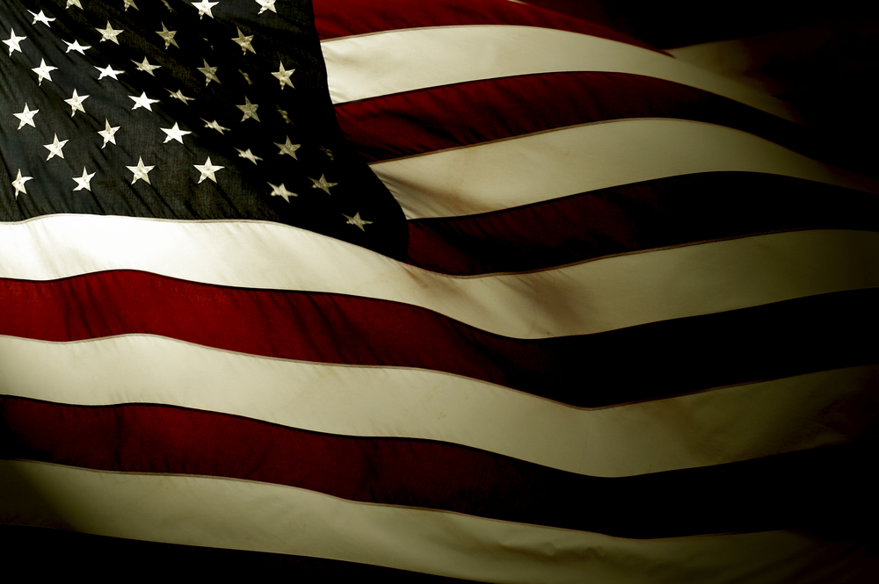
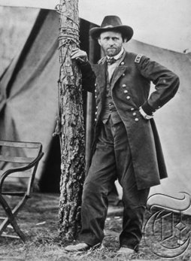
Monday, April 11th, 2016
Pick up a reading packet from the back- DO NOT WRITE ON IT!
Fill out Table of Contents
Pg. 100-101) Who’s Who: Reformers
Pg. 102) UGRR Map
Pg. 103) Civil War Vocabulary
Pg. 104-105) Causes of the Civil War
Pg. 106) Causes Quiz
Pg. 107) Northern Leaders
Today I will:
Read informational text and discover the main points and organize them in my notes

Slide 2
Pg. 107) Northern Leaders
Create 8 boxes using your WHOLE paper.
On your own, read about each Northern Leaders and write down the important points about them in each correlating box.
*if you finish early make sure ALL pgs are completed and GLUED in- notebook check tomorrow
Abraham Lincoln | Clara Barton
Ulysses S Grant | Fredrick Douglass
William T. Sherman | John Brown
George B. McCellan | Philip H. Sheridan

Slide 3
Tuesday, April 12th, 2016
Fill out Table of Contents
Pg. 100-101) Who’s Who: Reformers
Pg. 102) UGRR Map
Pg. 103) Civil War Vocabulary
Pg. 104-105) Causes of the Civil War
Pg. 106) Causes Quiz
Pg. 107) Northern Leaders
Pg. 108-109) Northern Leader Journal Entry
Pg. 110) Southern Leaders
Today I will:
Take the information I learned about the Northern Leaders and creatively show my knowledge

Slide 4
Pgs. 108-109) Northern Journal Entry
Write a journal entry or series of entries from the perspective of one of the following Northern Leaders:
Ulysses S. Grant
William Sherman
George B. McCellan
Clara Barton
John Brown
Fredrick Douglass
Philip Sheridan
*you CANNOT choose Abraham Lincoln
HIGHLIGHT :
Include at least 2 facts about your leader as well as at least
3 vocabulary terms and at least 1 location.
HIGHLIGHT :

Slide 5
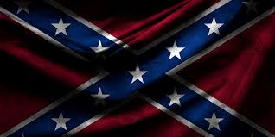
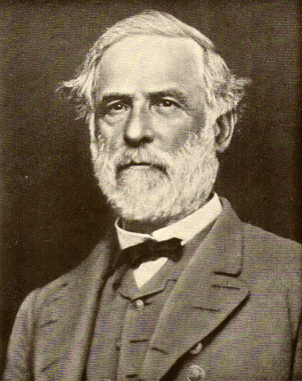
Wednesday, April 13th, 2016
Pick up a reading packet from the back- DO NOT WRITE ON IT!
Fill out Table of Contents
Pg. 100-101) Who’s Who: Reformers
Pg. 102) UGRR Map
Pg. 103) Civil War Vocabulary
Pg. 104-105) Causes of the Civil War
Pg. 106) Causes Quiz
Pg. 107) Northern Leaders
Pg. 108-109) Northern Leader Journal Entry
Pg. 110) Southern Leaders
Today I will:
Read informational text and discover the main points and organize them in my notes

Slide 6
Thursday, April 14th, 2016
Fill out Table of Contents
Pg. 100-101) Who’s Who: Reformers
Pg. 102) UGRR Map
Pg. 103) Civil War Vocabulary
Pg. 104-105) Causes of the Civil War
Pg. 106) Causes Quiz
Pg. 107) Northern Leaders
Pg. 108-109) Northern Leader Journal Entry
Pg. 110) Southern Leaders
Pg. 111-112) Southern Leaders Journal Entry
Today I will:
Take the information I learned about the Southern Leaders and creatively show my knowledge

Slide 7
Pgs. 111-112) Southern Journal Entry
Write a journal entry or series of entries from the perspective of one of the following Southern Leaders:
Jefferson Davis
Robert E. Lee
Thomas “Stonewall” Jackson
James Longstreet
John Hunt Morgan
John Singleton Mosby
Nathan Bedford Forest
HIGHLIGHT :
Include at least 2 facts about your leader as well as at least
3 vocabulary terms and at least 1 location.
HIGHLIGHT :

